Slide 1
ADDRESS BY THE PRESIDENT
DAWAKIN TOFA SCIENCE COLLEGE OLD STUDENTS ASSOCIATION
(DATSSOSA) CLASS 2000
ON THE OCCASION OF DATSOSA2000 15 YEARS ANNIVERSSARY CELEBRATION
Presented by Engr Zaraddeen Hamisu
14/11/2015

Slide 2
INTRODUCTION
Bismillahir Rahmanir Raheem and Assalamu Alaykum (WRTW)
We give all thanks to Almighty Allah for making us to be part of this memorable occasion. May continue to increase us in Iman and good health.
I’m glad to welcome everyone at this occasion; our fathers, the staff of our prestigious college, DATSSOSA2000 members, the students, especially the new student.
DATSSOSA2000 is the daughter of the mother association of Dawakin Tofa Sceince College old students (DATSSOSA).
The first set of DATSSOSA2000 students resumed Dawakin Tofa Science College in September, 1997, with Rabi’u Sani Kunya as the first student.
We left Dawakin Tofa Science College on the July 24th, 2000. Fifteen years back

Slide 3
OUR ACHIEVEMENTS
The main objective of the association is to unite and assist its members and also to help Dawakin Tofa Science College within the association’s ability.
Among the achievements of DATSSOSA 2000 Students include:
We were the first set of students:
To write NECO exam in the history of Dawakin Tofa Science College.
To record the best performance in final year examination in the history of Dawakin Tofa Science College
With the highest number of students that got admission immediately after graduation from Dawaki.

Slide 4
Achievements contd’
DATSSOSA2000 was the first Dawakin Tofa old students association to create a project called “e-PROJECT” to put all what people need to know about Dawakin Tofa Science College on the internet
DATSSOSA2000 was the first Dawakin Tofa old students association to create a website to make its activities online

Slide 5
DATSSOSA2000 WEBSITE

Slide 6
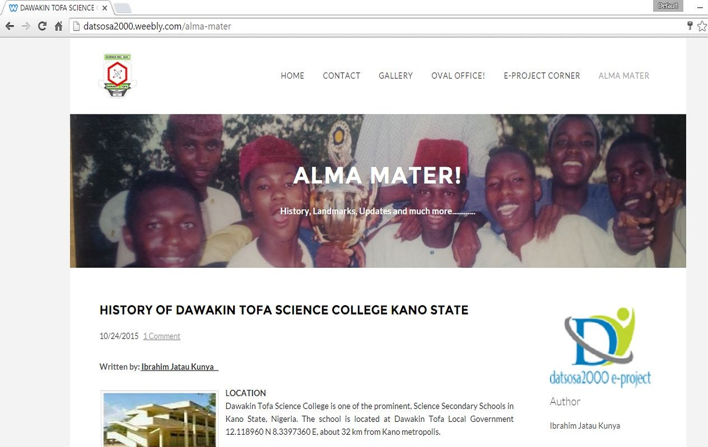
ALMA MATA

Slide 7
DATSSOSA2000 -PROJECT

Slide 8
15 YEARS ANNIVERSARY CELEBRATION
This event is our second official visit to Dawakin Tofa Science College.
The anniversary celebration is to mark the 15 years of our graduation from Dawakin Tofa Science College in July, 2000.
The activities line up for the celebrations include:
Interactions with the school community.
Carrier guidance talks.
Donations
Football competition.
And lot’s more

Slide 9
I wish everybody a successful anniversary celebration.
I would like to thanks the management of Dawakin Tofa Science College especially Malam Shehu Umar for his fatherly guidance and support
May almighty Allah make it easy for all of us and take everybody back to his destination safely
THANK YOU ALL!!
Pharm Ibrahim Jatau Kunya

